Slide 1
CS162
Operating Systems and
Systems Programming
Lecture 9
Tips for Working in a Project Team/ Cooperating Processes and Deadlock
September 29, 2010
Prof. John Kubiatowicz
http://inst.eecs.berkeley.edu/~cs162

Slide 2
Review: Definition of Monitor
Semaphores are confusing because dual purpose:
  Both mutual exclusion and scheduling constraints
  Cleaner idea: Use locks for mutual exclusion and condition variables for scheduling constraints
Monitor: a lock and zero or more condition variables for managing concurrent access to shared data
  Use of Monitors is a programming paradigm
Lock: provides mutual exclusion to shared data:
  Always acquire before accessing shared data structure
  Always release after finishing with shared data
Condition Variable: a queue of threads waiting for something inside a critical section
  Key idea: allow sleeping inside critical section by atomically releasing lock at time we go to sleep
  Contrast to semaphores: Can’t wait inside critical section

Slide 3
Review: Programming with Monitors
Monitors represent the logic of the program
  Wait if necessary
  Signal when change something so any waiting threads can proceed
Basic structure of monitor-based program:
  lock
  while (need to wait) {
  condvar.wait();
  }
  unlock
  do something so no need to wait
  lock
  condvar.signal();
  unlock
Check and/or update
state variables
Wait if necessary
Check and/or update
state variables

Slide 4
Goals for Today
Tips for Programming in a Project Team
Language Support for Synchronization
Discussion of Deadlocks
  Conditions for its occurrence
  Solutions for breaking and avoiding deadlock
Note: Some slides and/or pictures in the following are
adapted from slides ©2005 Silberschatz, Galvin, and Gagne
Note: Some slides and/or pictures in the following are
adapted from slides ©2005 Silberschatz, Galvin, and Gagne. Many slides generated from my lecture notes by Kubiatowicz.

Slide 5

Tips for Programming in a Project Team
Big projects require more than one person (or long, long, long time)
  Big OS: thousands of person-years!
It’s very hard to make software
project teams work correctly
  Doesn’t seem to be as true of big construction projects
    Empire state building finished in one year: staging iron production thousands of miles away
    Or the Hoover dam: built towns to hold workers
  Is it OK to miss deadlines?
    We make it free (slip days)
    Reality: they’re very expensive as time-to-market is one of the most important things!
“You just have
to get your
synchronization right!”

Slide 6
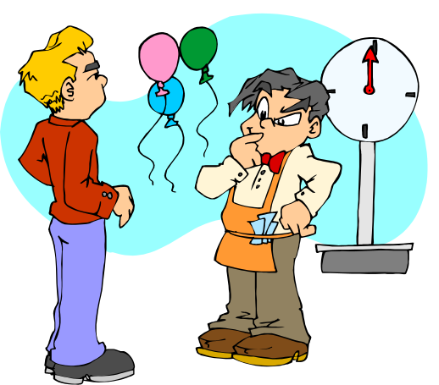

Big Projects
What is a big project?
  Time/work estimation is hard
  Programmers are eternal optimistics
  (it will only take two days)!
    This is why we bug you about
    starting the project early
    Had a grad student who used to say he just needed
    “10 minutes” to fix something. Two hours later…
Can a project be efficiently partitioned?
  Partitionable task decreases in time as
  you add people
  But, if you require communication:
    Time reaches a minimum bound
    With complex interactions, time increases!
  Mythical person-month problem:
    You estimate how long a project will take
    Starts to fall behind, so you add more people
    Project takes even more time!

Slide 7
Techniques for Partitioning Tasks
Functional
  Person A implements threads, Person B implements semaphores, Person C implements locks…
  Problem: Lots of communication across APIs
    If B changes the API, A may need to make changes
    Story: Large airline company spent $200 million on a new scheduling and booking system. Two teams “working together.” After two years, went to merge software. Failed! Interfaces had changed (documented, but no one noticed). Result: would cost another $200 million to fix.
Task
  Person A designs, Person B writes code, Person C tests
  May be difficult to find right balance, but can focus on each person’s strengths (Theory vs systems hacker)
  Since Debugging is hard, Microsoft has two testers for each programmer
Most CS162 project teams are functional, but people have had success with task-based divisions

Slide 8

Communication
More people mean more communication
  Changes have to be propagated to more people
  Think about person writing code for most
  fundamental component of system: everyone depends
  on them!
Miscommunication is common
  “Index starts at 0? I thought you said 1!”
Who makes decisions?
  Individual decisions are fast but trouble
  Group decisions take time
  Centralized decisions require a big picture view (someone who can be the “system architect”)
Often designating someone as the system architect can be a good thing
  Better not be clueless
  Better have good people skills
  Better let other people do work

Slide 9

Coordination
More people ⇒ no one can make all meetings!
  They miss decisions and associated discussion
  Example from earlier class: one person missed
  meetings and did something group had rejected
  Why do we limit groups to 5 people?
    You would never be able to schedule meetings otherwise
  Why do we require 4 people minimum?
    You need to experience groups to get ready for real world
People have different work styles
  Some people work in the morning, some at night
  How do you decide when to meet or work together?
What about project slippage?
  It will happen, guaranteed!
  Ex: phase 4, everyone busy but not talking. One person way behind. No one knew until very end – too late!
Hard to add people to existing group
  Members have already figured out how to work together

Slide 10

How to Make it Work?
People are human. Get over it.
  People will make mistakes, miss meetings, miss deadlines, etc. You need to live with it and adapt
  It is better to anticipate problems than clean up afterwards.
Document, document, document
  Why Document?
    Expose decisions and communicate to others
    Easier to spot mistakes early
    Easier to estimate progress
  What to document?
    Everything (but don’t overwhelm people or no one will read)
  Standardize!
    One programming format: variable naming conventions, tab indents,etc.
    Comments (Requires, effects, modifies)—javadoc?

Slide 11

Suggested Documents for You to Maintain
Project objectives: goals, constraints, and priorities
Specifications: the manual plus performance specs
  This should be the first document generated and the last one finished
Meeting notes
  Document all decisions
  You can often cut & paste for the design documents
Schedule: What is your anticipated timing?
  This document is critical!
Organizational Chart
  Who is responsible for what task?

Slide 12

Use Software Tools
Source revision control software
  (Subversion, CVS, others…)
  Easy to go back and see history/undo mistakes
  Figure out where and why a bug got introduced
  Communicates changes to everyone (use CVS’s features)
Use automated testing tools
  Write scripts for non-interactive software
  Use “expect” for interactive software
  JUnit: automate unit testing
  Microsoft rebuilds the Vista kernel every night with the day’s changes. Everyone is running/testing the latest software
Use E-mail and instant messaging consistently to leave a history trail

Slide 13

Test Continuously
Integration tests all the time, not at 11pm
on due date!
  Write dummy stubs with simple functionality
    Let’s people test continuously, but more work
  Schedule periodic integration tests
    Get everyone in the same room, check out code, build, and test.
    Don’t wait until it is too late!
Testing types:
  Unit tests: check each module in isolation (use JUnit?)
  Daemons: subject code to exceptional cases
  Random testing: Subject code to random timing changes
Test early, test later, test again
  Tendency is to test once and forget; what if something changes in some other part of the code?

Slide 14
Administrivia
Project 1 Code (and final design document)
  Due Tuesday 10/5 (next Tuesday!), Document Wednesday
  Project 2 starts after you are done with Project 1
Autograder issues
  Autograder not intended to run frequently at beginning
    Assume running every 4 hours or so at beginning of week
  We did have problems over the weekend
    Hopefully fixed by now
Midterm I coming up in three weeks:
  Monday, 10/18, Location: 155 Dwinelle
  Will be 3 hour exam in evening (5:30-8:30 or 6:00-9:00)
    Should be 2 hour exam with extra time
  Closed book, one page of hand-written notes (both sides)
  Topics: Everything up to previous Wednesday
No class on day of Midterm
I will post extra office hours for people who have questions about the material (or life, whatever)

Slide 15
C-Language Support for Synchronization
C language: Pretty straightforward synchronization
  Just make sure you know all the code paths out of a critical section
  int Rtn() {
  lock.acquire();
  …
  if (exception) {
  lock.release();
  return errReturnCode;
  }
  …
  lock.release();
  return OK;
  }
  Watch out for setjmp/longjmp!
    Can cause a non-local jump out of procedure
    In example, procedure E calls longjmp, poping stack back to procedure B
    If Procedure C had lock.acquire, problem!
Proc A
Proc B
Calls setjmp
Stack growth
Proc C
lock.acquire
Proc D
Proc E
Calls longjmp

Slide 16
C++ Language Support for Synchronization
Languages with exceptions like C++
  Languages that support exceptions are problematic (easy to make a non-local exit without releasing lock)
  Consider:
  void Rtn() {
  lock.acquire();
  …
  DoFoo();
  …
  lock.release();
  }
  void DoFoo() {
  …
  if (exception) throw errException;
  …
  }
  Notice that an exception in DoFoo() will exit without releasing the lock

Slide 17
C++ Language Support for Synchronization (con’t)
Must catch all exceptions in critical sections
  Catch exceptions, release lock, and re-throw exception:
  void Rtn() {
  lock.acquire();
  try {
  …
  DoFoo();
  …
  } catch (…) { // catch exception
  lock.release(); // release lock
  throw; // re-throw the exception
  }
  lock.release();
  }
  void DoFoo() {
  …
  if (exception) throw errException;
  …
  }
  Even Better: auto_ptr<T> facility. See C++ Spec.
    Can deallocate/free lock regardless of exit method

Slide 18
Java Language Support for Synchronization
Java has explicit support for threads and thread synchronization
Bank Account example:
class Account {
private int balance;
// object constructor
public Account (int initialBalance) {
balance = initialBalance;
}
public synchronized int getBalance() {
return balance;
}
public synchronized void deposit(int amount) {
balance += amount;
}
}
  Every object has an associated lock which gets automatically acquired and released on entry and exit from a synchronized method.

Slide 19
Java Language Support for Synchronization (con’t)
Java also has synchronized statements:
synchronized (object) {
…
}
  Since every Java object has an associated lock, this type of statement acquires and releases the object’s lock on entry and exit of the body
  Works properly even with exceptions:
  synchronized (object) {
  …
  DoFoo();
  …
  }
  void DoFoo() {
  throw errException;
  }

Slide 20
Java Language Support for Synchronization (con’t 2)
In addition to a lock, every object has a single condition variable associated with it
  How to wait inside a synchronization method of block:
    void wait(long timeout); // Wait for timeout
    void wait(long timeout, int nanoseconds); //variant
    void wait();
  How to signal in a synchronized method or block:
    void notify(); // wakes up oldest waiter
    void notifyAll(); // like broadcast, wakes everyone
  Condition variables can wait for a bounded length of time. This is useful for handling exception cases:
  t1 = time.now();
  while (!ATMRequest()) {
  wait (CHECKPERIOD);
  t2 = time.new();
  if (t2 – t1 > LONG_TIME) checkMachine();
  }
  Not all Java VMs equivalent!
    Different scheduling policies, not necessarily preemptive!

Slide 21
Resource Contention
and
Deadlock

Slide 22

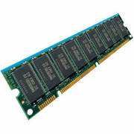

Resources
Resources – passive entities needed by threads to do their work
  CPU time, disk space, memory
Two types of resources:
  Preemptable – can take it away
    CPU, Embedded security chip
  Non-preemptable – must leave it with the thread
    Disk space, plotter, chunk of virtual address space
    Mutual exclusion – the right to enter a critical section
Resources may require exclusive access or may be sharable
  Read-only files are typically sharable
  Printers are not sharable during time of printing
One of the major tasks of an operating system is to manage resources

Slide 23
Starvation vs Deadlock
Starvation vs. Deadlock
  Starvation: thread waits indefinitely
    Example, low-priority thread waiting for resources constantly in use by high-priority threads
  Deadlock: circular waiting for resources
    Thread A owns Res 1 and is waiting for Res 2
    Thread B owns Res 2 and is waiting for Res 1
  Deadlock ⇒ Starvation but not vice versa
    Starvation can end (but doesn’t have to)
    Deadlock can’t end without external intervention
Thread
A
Wait
For
Owned
By
Res 1
Res 2
Owned
By
Wait
For
Thread
B

Slide 24
Conditions for Deadlock
Deadlock not always deterministic – Example 2 mutexes:
Thread A Thread B
x.P(); y.P();
y.P(); x.P();
y.V(); x.V();
x.V(); y.V();
  Deadlock won’t always happen with this code
    Have to have exactly the right timing (“wrong” timing?)
    So you release a piece of software, and you tested it, and there it is, controlling a nuclear power plant…
Deadlocks occur with multiple resources
  Means you can’t decompose the problem
  Can’t solve deadlock for each resource independently
Example: System with 2 disk drives and two threads
  Each thread needs 2 disk drives to function
  Each thread gets one disk and waits for another one

Slide 25



Bridge Crossing Example
Honk!
Each segment of road can be viewed as a resource
  Car must own the segment under them
  Must acquire segment that they are moving into
For bridge: must acquire both halves
  Traffic only in one direction at a time
  Problem occurs when two cars in opposite directions on bridge: each acquires one segment and needs next
If a deadlock occurs, it can be resolved if one car backs up (preempt resources and rollback)
  Several cars may have to be backed up
Starvation is possible
  East-going traffic really fast ⇒ no one goes west

Slide 26


Train Example (Wormhole-Routed Network)
Circular dependency (Deadlock!)
  Each train wants to turn right
  Blocked by other trains
  Similar problem to multiprocessor networks
Fix? Imagine grid extends in all four directions
  Force ordering of channels (tracks)
    Protocol: Always go east-west first, then north-south
  Called “dimension ordering” (X then Y)
Disallowed
By Rule

Slide 27

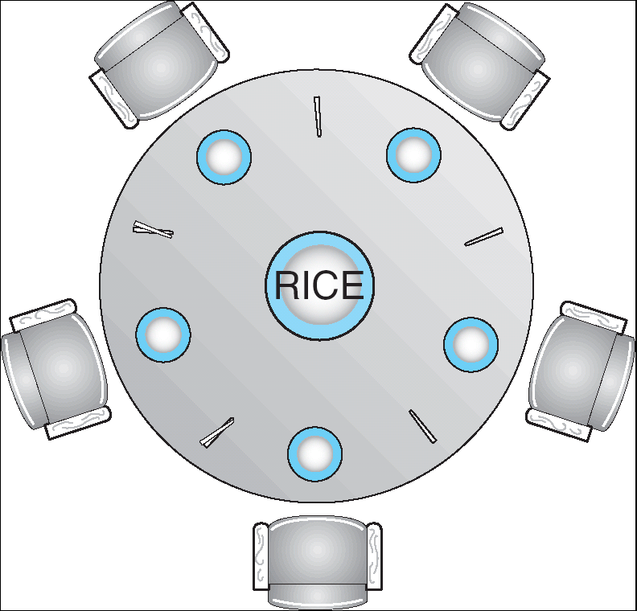

Dining Lawyers Problem
Five chopsticks/Five lawyers (really cheap restaurant)
  Free-for all: Lawyer will grab any one they can
  Need two chopsticks to eat
What if all grab at same time?
  Deadlock!
How to fix deadlock?
  Make one of them give up a chopstick (Hah!)
  Eventually everyone will get chance to eat
How to prevent deadlock?
  Never let lawyer take last chopstick if no hungry lawyer has two chopsticks afterwards

Slide 28
Four requirements for Deadlock
Mutual exclusion
  Only one thread at a time can use a resource.
Hold and wait
  Thread holding at least one resource is waiting to acquire additional resources held by other threads
No preemption
  Resources are released only voluntarily by the thread holding the resource, after thread is finished with it
Circular wait
  There exists a set {T₁, …, T_{n}} of waiting threads
    T₁ is waiting for a resource that is held by T₂
    T₂ is waiting for a resource that is held by T₃
    …
    T_{n} is waiting for a resource that is held by T₁

Slide 29
Resource-Allocation Graph
Symbols
System Model
  A set of Threads T₁, T₂, . . ., T_{n}
  Resource types R₁, R₂, . . ., R_{m}
    CPU cycles, memory space, I/O devices
  Each resource type R_{i} has W_{i} instances.
  Each thread utilizes a resource as follows:
    Request() / Use() / Release()
Resource-Allocation Graph:
  V is partitioned into two types:
    T = {T₁, T₂, …, T_{n}}, the set threads in the system.
    R = {R₁, R₂, …, R_{m}}, the set of resource types in system
  request edge – directed edge T₁ → R_{j}
  assignment edge – directed edge R_{j} → T_{i}
T₁
T₂
R₁
R₂

Slide 30
Resource Allocation Graph Examples
Recall:
  request edge – directed edge T₁ → R_{j}
  assignment edge – directed edge R_{j} → T_{i}
R₁
R₂
R₁
R₂
R₁
T₂
T₁
T₂
T₃
T₁
T₂
T₃
T₁
T₃
R₃
T₄
R₄
R₃
R₂
R₄
Simple Resource
Allocation Graph
Allocation Graph
With Deadlock
Allocation Graph
With Cycle, but
No Deadlock

Slide 31
Methods for Handling Deadlocks
Allow system to enter deadlock and then recover
  Requires deadlock detection algorithm
  Some technique for forcibly preempting resources and/or terminating tasks
Ensure that system will never enter a deadlock
  Need to monitor all lock acquisitions
  Selectively deny those that might lead to deadlock
Ignore the problem and pretend that deadlocks never occur in the system
  Used by most operating systems, including UNIX

Slide 32
Deadlock Detection Algorithm
Only one of each type of resource ⇒ look for loops
More General Deadlock Detection Algorithm
  Let [X] represent an m-ary vector of non-negative
  integers (quantities of resources of each type):
  [FreeResources]: Current free resources each type
  [Request_{X}]: Current requests from thread X
  [Alloc_{X}]: Current resources held by thread X
  See if tasks can eventually terminate on their own
[Avail] = [FreeResources]
Add all nodes to UNFINISHED
do {
done = true
Foreach node in UNFINISHED {
if ([Request_{node}] <= [Avail]) {
remove node from UNFINISHED
[Avail] = [Avail] + [Alloc_{node}]
done = false
}
}
} until(done)
  Nodes left in UNFINISHED ⇒ deadlocked
R₁
T₂
T₁
T₃
T₄
R₂

Slide 33
What to do when detect deadlock?
Terminate thread, force it to give up resources
  In Bridge example, Godzilla picks up a car, hurls it into the river. Deadlock solved!
  Shoot a dining lawyer
  But, not always possible – killing a thread holding a mutex leaves world inconsistent
Preempt resources without killing off thread
  Take away resources from thread temporarily
  Doesn’t always fit with semantics of computation
Roll back actions of deadlocked threads
  Hit the rewind button on TiVo, pretend last few minutes never happened
  For bridge example, make one car roll backwards (may require others behind him)
  Common technique in databases (transactions)
  Of course, if you restart in exactly the same way, may reenter deadlock once again
Many operating systems use other options

Slide 34
Summary
Suggestions for dealing with Project Partners
  Start Early, Meet Often
  Develop Good Organizational Plan, Document Everything,
  Use the right tools, Develop Comprehensive Testing Plan
  (Oh, and add 2 years to every deadline!)
Starvation vs. Deadlock
  Starvation: thread waits indefinitely
  Deadlock: circular waiting for resources
Four conditions for deadlocks
  Mutual exclusion
    Only one thread at a time can use a resource
  Hold and wait
    Thread holding at least one resource is waiting to acquire additional resources held by other threads
  No preemption
    Resources are released only voluntarily by the threads
  Circular wait
    ∃ set {T₁, …, T_{n}} of threads with a cyclic waiting pattern

Slide 35
Summary (2)
Techniques for addressing Deadlock
  Allow system to enter deadlock and then recover
  Ensure that system will never enter a deadlock
  Ignore the problem and pretend that deadlocks never occur in the system
Deadlock detection
  Attempts to assess whether waiting graph can ever make progress
Next Time: Deadlock prevention
  Assess, for each allocation, whether it has the potential to lead to deadlock
  Banker’s algorithm gives one way to assess this

